Slide 1
Installation & configuration
Victor Havard vhavard@us.ibm.com
Robert Rohlin rrohlin@us.ibm.com

Slide 2
Objectives
After completing this lecture, you will be able to:
Identify differences between CE and EE versions
List ICp server types
List hardware and software prerequisites to installing ICp
Know what Dynamic Storage provisioning does and list the more common storage options that you might see at customer sites
Configure secure communications between servers in the cluster
List properties for configuring networking with Calico
Locate valuable resources for installing and configuring ICp
Identify essential concepts
Docker – containers versus images
Installation broad strokes
Potential installation issues
Cloud Foundry

Slide 3
ICP Features:
IBM® Cloud private management console
Manage, monitor, and troubleshoot your applications and cluster from a single, centralized, and secure management console.
Private Docker image registry
The private docker registry integrates with the Docker registry V2 API to provide a local registry service that functions in the same way as the cloud-based registry service, Docker Hub. This local registry has all the same features as Docker Hub but also allows you to restrict which users can view or pull images.

Slide 4
ICP Features (continued)
An app center
The app center provides a centralized location from which you can browse for and install packages in your cluster. The following default packages are available with the initial installation:
Apache Tomcat
Galera Cluster for MySQL
IBM Spectrum LSF® Community Edition
Jenkins
Nginx
Redis
Sock Shop - A Microservices demo application

Slide 5
ICP Features (continued)
WebSphere® Liberty
Web Terminal
Isolated Tenant Networks – Use Calico to create isolated subnets for each project to add security during data transmissions and reduces the chances of compromising applications and their data.
Robust monitoring and logging with ELK stack -- IBM® Cloud private uses these components to collect, store, and query logs and metrics.
Elasticsearch
Logstash
Kibana
Filebeat
Heapster

Slide 6
ICp Community Edition (CE)
Free, limited offering for test environments
When installing CE, the installer only puts necessary containers on each machine (e.g. boot, master, proxy, worker) for the services that machine supports.
CE supports single node control plane
CE has community support (website)
No support for high-availability (HA) installations

Slide 7
ICp Enterprise Edition (EE)
Customer-managed container solution for enterprises (managed service available)
When installing EE, the installer puts all containers (50+) on every machine (e.g. boot, master, proxy, worker).
This represents approximately 4Gb of SCP data transfer from the boot/master to each machine in the cluster which can take a while.
Plan NFS install or other activity during this time.
EE supports Highly Available (HA) control plane with 3 or 5 master and proxy nodes
Enterprise Edition offers SLAs and Enterprise Support

Slide 8
ICp server types
Boot node -- Used for running installation, configuration, node scaling, and cluster updates. Only one boot node is required for any cluster. You can use a single node for both master and boot.
Master node -- A master node provides management services (such as resource allocation, scheduling, and monitoring) and controls the worker nodes in a cluster.
Worker node -- A worker node is a node that provides a containerized environment for running tasks. Add worker nodes as demands increase to improve performance and efficiency.
Proxy Node -- Transmits external request to the services created inside your cluster. A cluster must contain at least one proxy node if load balancing is required inside the cluster.

Slide 9
Minimal hardware guidelines
Requirement | Boot node | Master node | Proxy node | Worker node
Number of hosts | 1 | 1, 3, or 5 | 1, 3, or 5 | 1 or more
Cores used (*more cores is more important than more RAM) | 1 or more | 2 | 1 or more | 1 or more
CPU power | >= 2.4 Ghz | >= 2.4 Ghz | >= 2.4 Ghz | >= 2.4 Ghz
RAM | 4 Gb | 8 Gb | 4 Gb | 4 Gb
Disk space | 70-150Gb | 70-150Gb (Includes 30Gb for Elasticsearch DB) | 70-150Gb | 70-150Gb
Notes:
40Gb is the minimum required disk space
But 70-150 is recommended to add space for Elasticsearch and other management tools

Slide 10
Suggested hardware guidelines
Master node (only 1 master node / cluster if HA not required):
Small to mid-installations: 4 vCPUs, 16-64 GB RAM (depending on # of worker nodes)
Proxy node:
2 CPUs, 8 Gb RAM
Worker nodes:
4-8 CPUs, 8-16 GB RAM depending on implementation size
Recommend 3 worker nodes for standard installation and then increase with workload requirements.

Slide 11
Supported operating systems
Platform | Operating system
Linux™ 64-bit | Red Hat Enterprise Linux (RHEL) 7.1 and 7.2
 | Ubuntu 16.04 LTS (recommended due to ease of installing prerequisites)
Linux on POWER 64-bit Little Endian (LE) | Red Hat Enterprise Linux (RHEL) 7.1 and 7.2
 | Ubuntu 16.04 LTS (recommended due to ease of installing prerequisites)
IBM® Z | Red Hat Enterprise Linux (RHEL) 7.1 and 7.2
 | Ubuntu 16.04 LTS (recommended due to ease of installing prerequisites)

Slide 12
Supported operating systems (2)
Node type | Linux 64-bit (x86_84) | Linux on POWER 64-bit Little Endian (LE) (ppc64le) | IBM® Z (s390x)
Master | Y | Y | X
Proxy | Y | Y | X
Worker | Y | Y | Y

Slide 13
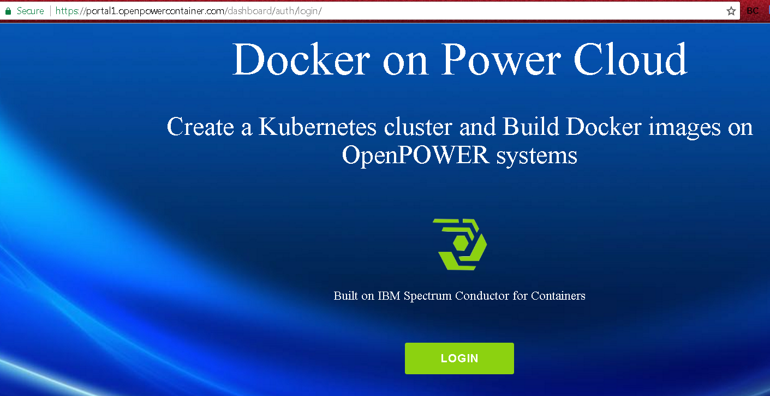
IBM Cloud private on Power
Login with IBMid to: https://portal1.openpowercontainer.com/dashboard/auth/login/
Join the Slack channel: https://ibm-cloud-tech.slack.com/messages/C5S7HG0TD/ (#power-docker-cloud)

Slide 14
Installing on Power
Installation on Power differs only slightly from Ubuntu or Red Hat installation:
Operating system components and libraries might have different names
The command to install ICP on Power is slightly different:
docker run --net=host -t -e LICENSE=accept -v $(pwd):/installer/cluster ppc64le/icp-inception:2.1.0-s4-rc1-ee

Slide 15
What is needed for each operating system
Optional: Install GUI for server (only on master)
Configure Network Time Protocol (NTP)
Install extra Linux packages
Configure memory map counts for indices storage (covered in tutorial), e.g. sysctl -w vm.max_map_count=262144
Optional: Add GNU Privacy Guard (GPG) which is used to sign and verify files
Regarding Ubuntu vs. Red Hat
Red Hat servers will require a subscription to a yum repository to download components (e.g. yum install glusterfs-client)
Ubuntu has no such requirement as you can use the open source apt-get (e.g. apt-get install glusterfs-client)
Notes:
#sudo apt-get update #sudo apt-get install glusterfs-client #sudo modprobe dm_thin_pool #echo dm_thin_pool | sudo tee -a /etc/modules On Red Hat Enterprise Linux:
#sudo yum install glusterfs-client

Slide 16
Supported Docker versions
IBM Cloud private is distributed as a Docker package
Supported versions
Docker Enterprise Edition
1.12 to 1.13.1
17.03
Docker Community Edition
1.12 to 1.13.1
17.06
┌ Note ─────────────────
Plans are that the GA version of ICP 2.1 will install Docker for you.
└────────────────────

Slide 17
The config.yaml file
After you copy the files from the install container, you modify the config.yaml file before running the installer.
The config.yaml file contains all the configuration settings that are needed to deploy your cluster and install ICp software. It controls the way in which ICP is installed.
The config.yaml also contains a list of the Docker images that are pulled from Docker Hub by the installer during the IBM® Cloud private-ce (Community Edition) installation process. (The Enterprise Edition installs all containers on each server by default.)
┌ Note ─────────────────
The GA version will have a GUI configuration utility. At some future point, this GUI will also install the Kubernetes and Cloud Foundry components.
└────────────────────

Slide 18
Installation overview

Slide 19
Where do I get the installation software?
For EE version -- download the latest build from Xtreme Leverage (XL) or Passport Advantage (PPA)
For CE version – available on the public Docker hub
Docker container installation files will be available in github.ibm.com
For installation steps, consult your tutorial material.
Also, see: https://www.ibm.com/support/knowledgecenter/SSBS6K_2.1.0/installing/install_containers.html

Slide 20
Installation overview
For EE -- Download the installation *.gz file and run the installation
The installer pulls down additional containers from Docker Hub for CE local repo for EE
For CE – Get container from Docker public repository
Supported for RHEL and Ubuntu on X, POWER and Z (workers only at this time)
Overall installation should take < 4 hours depending on scenario
(90% System Config, 10% Installation)
┌ Note ─────────────────
Except where otherwise noted, the installation steps in the following slides pertain to the Enterprise Edition (EE) of ICP
└────────────────────

Slide 21
Installation overview
Choose supported platform(s) (e.g. Ubuntu 16.0.4 TLS Server)
Set static IP addresses on each host
Install optional Linux components
Configure /etc/hosts file on each server with information on each node
Synchronize time on each server using Network Time Protocol (NTP)
Set vm.max_map_count on each host to be at least 262144
Verify that default ports are open (see https://www.ibm.com/support/knowledgecenter/SSBS6K_2.1.0/installing/prep_cluster.html)

Slide 22
Installation overview (continued)
Backup images to set base configuration
Determine authentication method (SSH or password)
Install Python if necessary
Install supported version of Docker
Start Docker
Install SSH client on each server
Configure and start LDAP server and confirm availability (if applicable)

Slide 23
Installation overview (continued)
Load the images into Docker (EE only)
For Linux™ 64-bit, run this command (substitute name of current *.gz file):
tar xf ibm-cloud-private-x86_64-2.1.0-s4-rc1.tar.gz -O | docker load
For Linux™ on Power® 64-bit LE, run this command:
tar xf ibm-cloud-private-ppc64le-2.1.0-s4-rc1.tar.gz -O | sudo docker load
Verify docker image name – docker image ls

Slide 24
Installation overview (continued)
Extract the sample configuration files from the installer image
docker run -v $(pwd):/data -e LICENSE=accept
ibmcom/icp-inception:2.1.0-s4-rc1-ee cp -r cluster /data
A ibm-cloud-private-x86_64-2.1.0-s4-rc1.tar directory (*or other directory based on the file name) is created inside your installation directory.

Slide 25
Installation overview (continued) – EE
Move the image files for your cluster to the <installation_directory>/cluster/images folder
Run installation script.
Add –vvv to installation command line for verbose error feedback if a previous installation has failed
Pipe the output to tee install.out file, you preserve all messages for support
docker run --net=host -t -e LICENSE=accept -v $(pwd):/installer/cluster ibmcom/icp-inception:2.1.0-s4-rc1-ee install –vvv | tee install.out 2>&1

Slide 26
Installation overview (continued)
Resolve installation errors
Backup installed servers/images

Slide 27
Problem determination

Slide 28
Objectives
After completing this topic, you will be able to:
Submit a knowledge asset into ARM
Indicate which logs need to be checked and where they are
Identify the “mustgathers” for solving a problem in this area
Understand the known limitations and dependencies
At least one example of a common problem or failure and how to resolve it
Any dependencies that could cause issues in this area
Extra Credit
Identify the squad that owns this code (or the parts of this code) and who is the leader of this squad

Slide 29
Common installation problems
If the installation fails with the message that the hostnames fail to resolve, but see an IP address instead of a hostname, the /etc/hosts files on the workstations in the cluster do not match.
Make sure that every /etc/hosts file matches exactly.
Easiest way to fix this is to use scp to copy the /etc/hosts file from the boot / master to all the other cluster members.
Run installation with the –vvv option and pipe it to a file (as seen in previous examples). You can then submit this “mustgather” file to support.
If you make a typo when adding a Docker repository, you will have a corrupted /etc/apt/sources.list file. You must remove the wrong entry, save the file, and then re-add the repository correctly. (The GA version should add the Docker repository for you.)

Slide 30
Entering a knowledge asset into ARM
1) Submit a knowledge asset into ARM here >> http://ibm.biz/ICP-ARM
2) Click “Create Asset Index” button
3) Enter Title, URL (if there is one), and the Description field
Problem/Solution
Question/Answer
4) Click “Save and Close”. Done/content is live for the chatbot to pick up.

